Slide 1
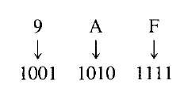
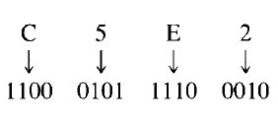
Hexadecimal to Binary Conversion
If you remember the previous table, we can simply convert each hexadecimal digit to its 4-bit binary equivalent
Examples

Slide 2
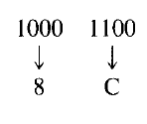
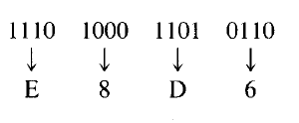
Binary to Hexadecimal Conversion
Now do the opposite!
Examples

Slide 3

Exercise
Find hexadecimal equivalent of
Find hexadecimal equivalents of

Slide 4
Exercise
Find binary equivalents of

Slide 5
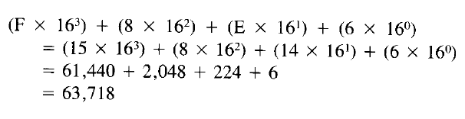
Hexadecimal to Decimal Conversion
Convert F8E6 in hexadecimal to decimal
Exercise: Now convert 63,718 in decimal to Hex. Do you get F8E6?

Slide 6
Solution
16 63718 6 in decimal .... 6 in hex
16 3982 14 in decimal .... E in hex
16 248 8 in decimal .... 8 in hex
16 15 15 in decimal .... F in hex
0
63718 in decimal = F8E6 in hex

Slide 7
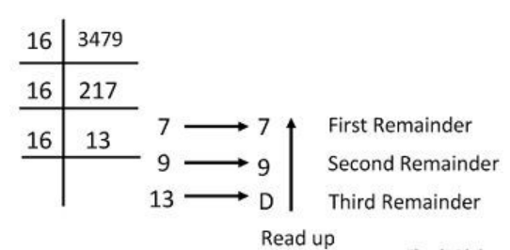
Decimal to Hexadecimal Conversion
Convert 3479 in decimal to hexadecimal

Slide 8
Conversion: Summary
Binary-to-Decimal: 8-4-2-1 method or multiply by 2^0, 2^1 etc from RHS
Decimal-to-Binary: Divide by 2, write quotient and remainder, finally write remainder in the reverse order
Hex-to-Decimal: multiply by 16^0, 16^1 etc from RHS
Decimal-to-Hex: Divide by 16, write quotient and remainder, finally write remainder in the reverse order
Binary-to-Hex: Write hex symbol for every four bits
Hex-to-Binary: Write 4-bit binary representation for every hex symbol

Slide 9
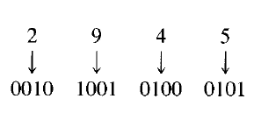
BCD Numbers
Binary-coded-Decimal (BCD) numbers express each decimal digit as a sequence of four bits
Example: Decimal number 2945 in BCD is 0010 1001 0100 0101

Slide 10
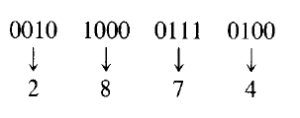
BCD to Decimal
Read four bits at a time and write the corresponding decimal digit

Slide 11
The ASCII Code
Computers need to deal with numbers, alphabets, and other symbols
But they only understand binary (0 and 1)
American Standard Code for Information Interchange (ASCII) = Code to map symbols to binary values
Initially 7-bit, then modified to 8-bit (Extended ASCII)

Slide 12
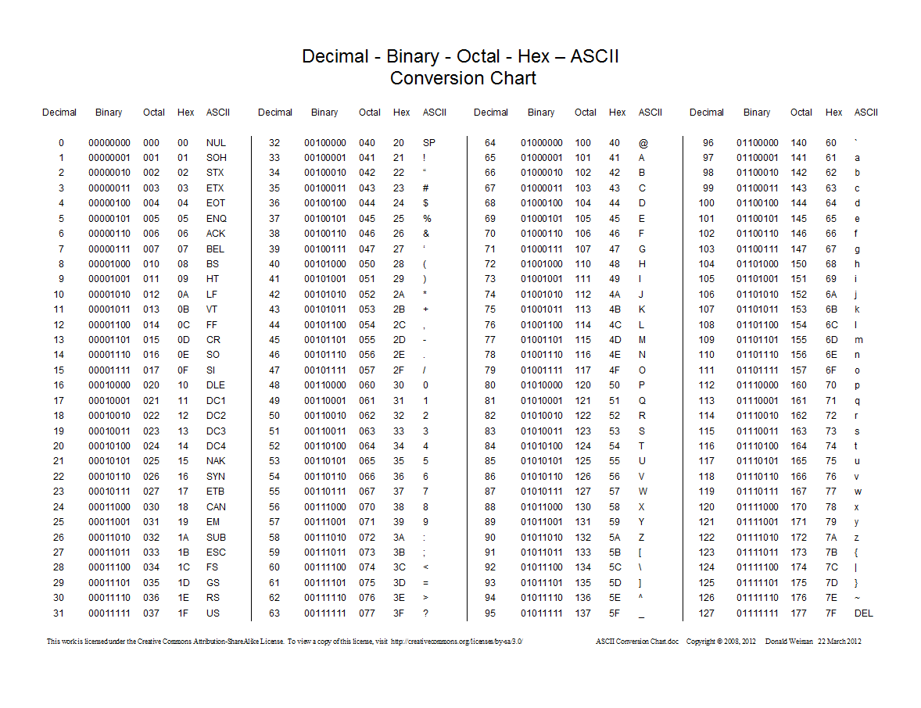
The ASCII Table

Slide 13
Unicode
Unicode is a universal character encoding standard
This standard includes roughly 100000 characters to represent characters of different languages
While ASCII uses only 1 byte the Unicode uses 4 bytes to represent characters
Hence, it provides a very wide variety of encoding

Slide 14
Binary Arithmetic

Slide 15
Binary Addition
Rules of binary addition
0 + 0 = 0
0 + 1 = 1
1 + 0 = 1
1 + 1 = 10
1 + 1 + 1 = 11

Slide 16
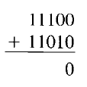
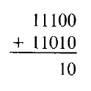
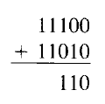
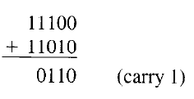
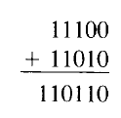
Binary Addition Example
Add two binary numbers: 11100 and 11010
Here, 1 + 1 + 1 (carry) produces 11, recorded as 1 with a carry of 1 to the next higher column

Slide 17
Binary Subtraction
Rules of binary subtraction
0 – 0 = 0
1 – 0 = 1
1 – 1 = 0
10 – 1 = 1

Slide 18
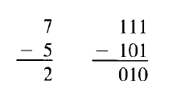
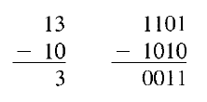
Binary Subtraction Example
Computers use different techniques for binary subtraction, as we will discuss soon

Slide 19
Signed Binary Numbers
Negative decimal numbers are -1, -2, -3, etc
For binary numbers, positive sign is 0 and negative sign is 1, so:
In binary 0001 means +1 and 1001 means -1
In binary 0010 means +2 and 1010 means -2, etc
Such numbers are called signed binary numbers or sign-magnitude numbers
Example: Express the following as 16-bit signed binary numbers:
+7, -7, +25, -25
Solution: Next slide

